Slide 1
Project presentation on Construction Dynamic Project
TEAM MEMBERS UNDER THE GUIDANCE OF
SINCHANA AB MURTHY P G SIR
INDU A
MUNAZZA KOUSAR

Slide 2
CONTENT
INTRODUCTION
CONSTRUCTION MANAGEMENT AND STATIC WEB
SOLUTIONS
KEY FEATURES
DYNAMIC CONTENT
ENGAGING UI/UX
TECHNOLOGY STACKS
BENEFITS
CONCLUSIONS

Slide 3
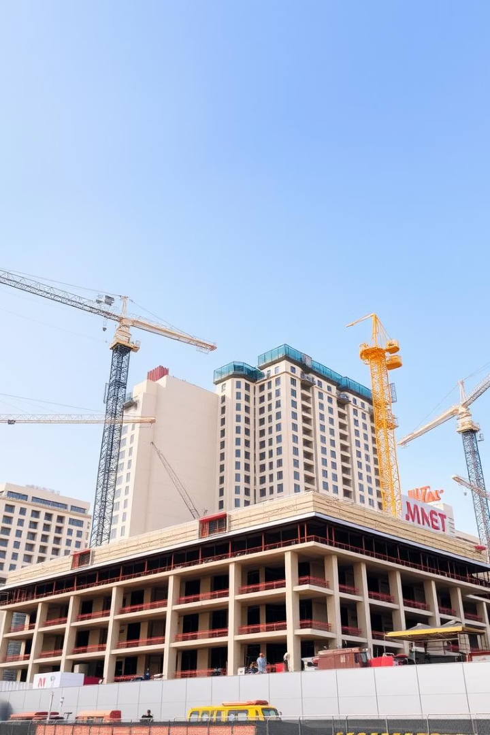
Construction Dynamic Project - Overview
The Construction Dynamic Project is a comprehensive construction company management system designed to streamline operations and enhance digital presence. It offers a powerful admin dashboard that enables dynamic management of projects, blogs, testimonials, and image content. The frontend website presents all this content through an engaging UI/UX design, offering visitors a modern and seamless browsing experience. This project aims to transform static, inefficient construction websites into vibrant, interactive platforms that empower both administrators and users.
Notes:
1

Slide 4

The Problem: Inefficient Construction Management & Static Websites
Outdated Management
Static Websites
Limited Content Control
Many construction companies rely on manual tracking and fragmented tools, leading to delays and errors in project oversight.
Static websites fail to reflect ongoing projects or fresh content dynamically, resulting in poor online engagement.
Admin teams struggle to frequently update blogs, testimonials, or images without developer reliance, decreasing agility.
Notes:
2

Slide 5
Our Solution: A Dynamic Management System & Engaging Frontend
Centralized Admin Dashboard
Real-Time Content Updates
Engaging Visitor Experience
A unified interface allows admins to efficiently manage projects, blogs, testimonials, and images without code.
Dynamic content delivery ensures the website reflects the latest project status, client feedback, and news.
The frontend emphasizes aesthetics and usability, keeping visitors informed and impressed throughout their journey.
Notes:
3

Slide 6


Key Features: Project Management Dashboard for Admins
Project Tracking
Monitor timelines, budgets, milestones, and team assignments with intuitive visual tools.
Blog Management
Quickly create, edit, and schedule construction-related articles to boost SEO and thought leadership.
Testimonial Reviews
Easily manage client feedback and display authentic testimonials dynamically on the website.
Image Library
Organize and update galleries showcasing projects and company highlights effortlessly.
Notes:
4

Slide 7
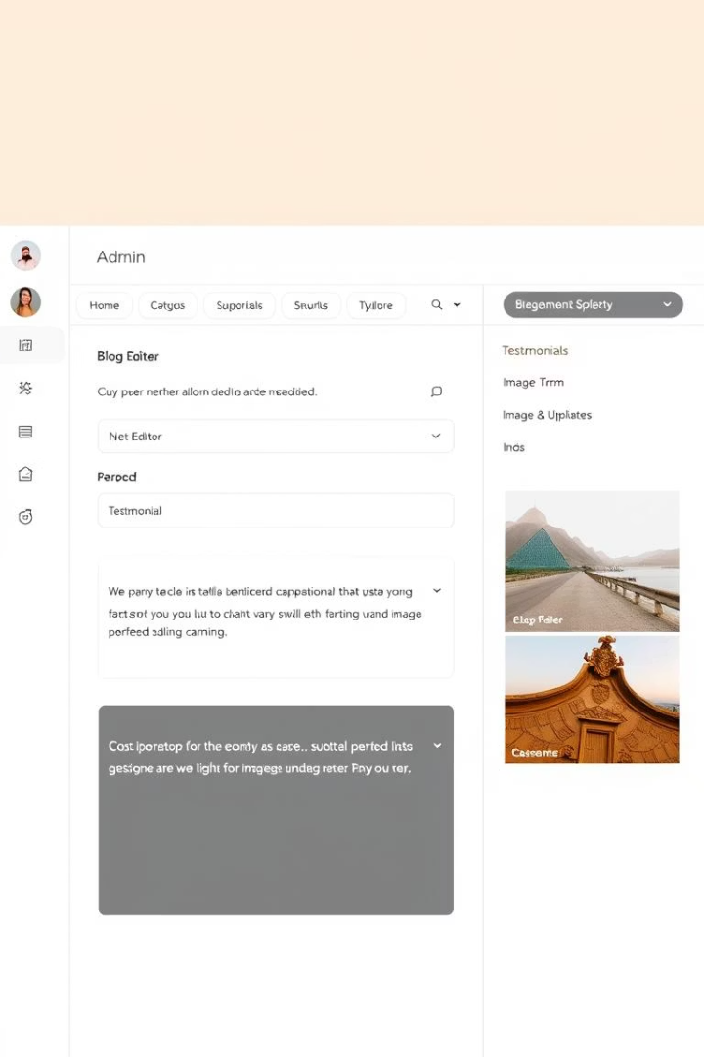



Dynamic Content: Manage Blogs, Testimonials, & Images Easily
Effortless Blog Creation
Admins can produce rich content with embedded images and formatting without technical skills.
Real-Time Testimonial Publishing
Client feedback is vetted and displayed instantly, building trust and transparency.
Seamless Image Updates
Drag-and-drop image uploads keep project galleries fresh and visually appealing.
Notes:
5

Slide 8
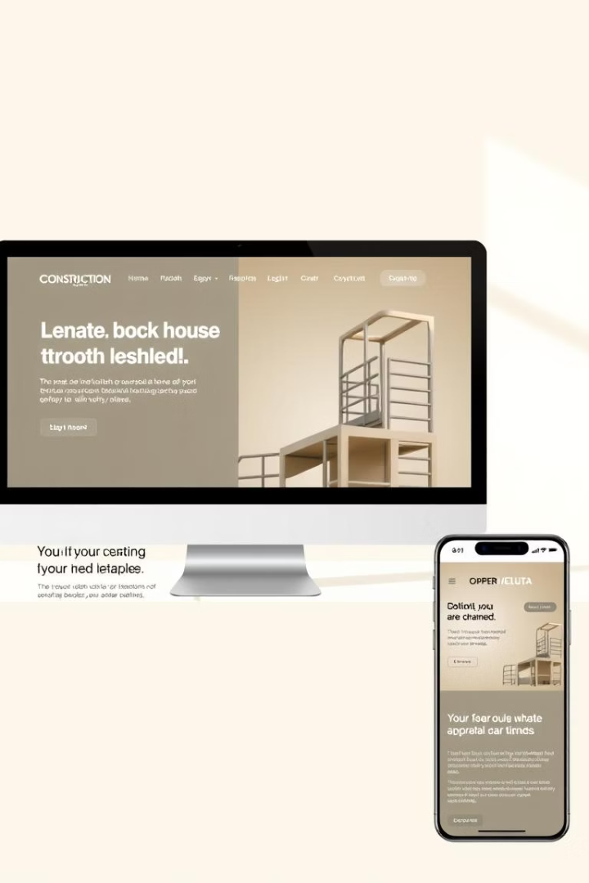



Engaging UI/UX: A Modern Website for Visitors
Responsive Design
Visual Storytelling
Fast Performance
Optimized code and media deliver quick load times, enhancing user satisfaction.
Website adapts beautifully for desktops, tablets, and smartphones for seamless access.
High-impact imagery and interactive elements immerse visitors in company projects.
Notes:
6

Slide 9
Technology Stack: Frontend & Backend Technologies Used
Frontend
Backend
Html ,css , Java script
SpringBoot with java for scalable server
Responsive CSS frameworks like Tailwind
MongoDB for flexible data storage
Dynamic content fetching via REST APIs
JWT Authentication for secure admin access
Notes:
7

Slide 10
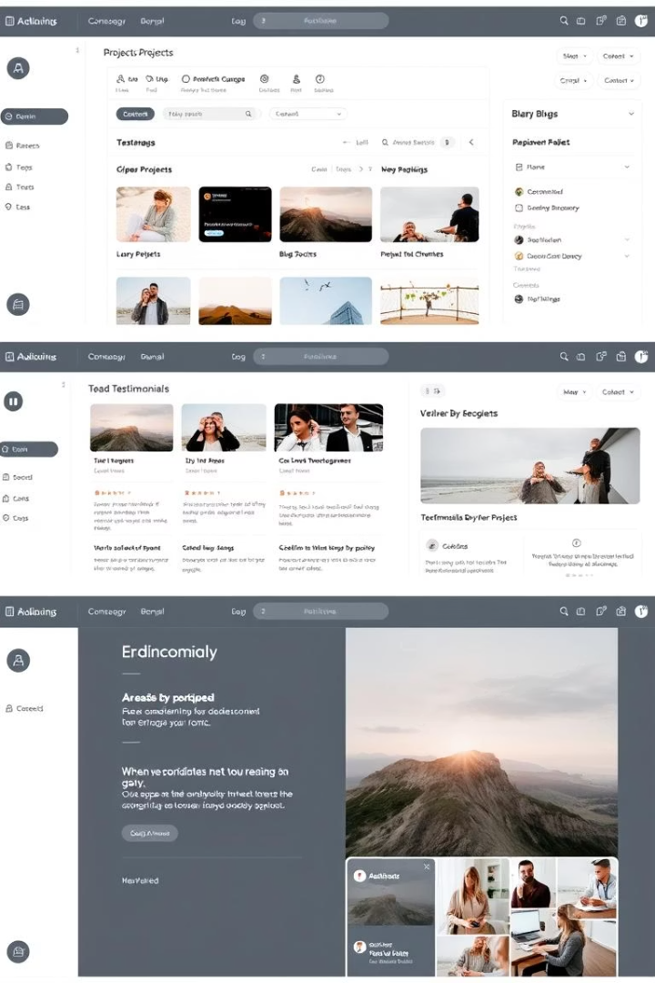
Demo: A Walkthrough of the System
Login & Access
Admins securely log in to the dashboard with role-based permissions.
Manage Projects
Create, update, and track project progress visually using integrated tools.
Update Content
Publish new blogs, moderate testimonials, and refresh images from one interface.
Live Preview
Immediately see changes reflected on the live frontend website for instant validation.
Notes:
8

Slide 11

Benefits: Streamlined Operations & Improved Online Presence
Operational Efficiency
Centralized tools reduce manual tasks and errors, saving time and resources.
Improved Visibility
Dynamic website content attracts and retains visitors, expanding business opportunities.
Enhanced Client Engagement
Authentic testimonials and updated projects build trust and brand loyalty.
Scalability
The system supports company growth with flexible content and user management.
Notes:
9

Slide 12

Conclusion
The Construction Dynamic Project redefines construction company management by combining a powerful admin dashboard and an engaging frontend experience. It resolves inefficiencies with centralized control and dynamic content, attracting visitors and clients effectively. Embracing modern technologies, the system scales with company growth and enriches online presence. With streamlined workflows and vivid storytelling, this solution empowers construction businesses to stand out in a competitive market and manage projects with confidence.
Next steps include further user feedback integration, mobile-specific enhancements, and expanding integrations with third-party tools for comprehensive utility.
Notes:
10

